Slide 1
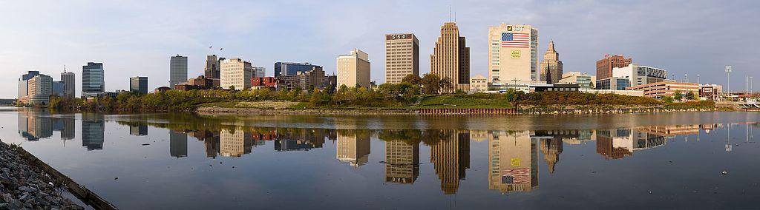
Newark vs. Jersey City
SAT business - client possibilities /
safety correlations / regressions - can growing economy and education help make us safer?

Slide 2
Introduction
I am an SAT tutor, and am starting a business. I want to find out which city is best to start in. I want to see how many schools there are. I will count the number of schools, the more the better. I will also try to narrow it down to type of schools, for instance high schools, not colleges. I like ice cream. Especially McDonald’s Ice Cream. I will search for all the McDonals within a radius of 1000 meters from each location, the more the better. I am also interested in safety. I am going to see if there is a correlation between US economy and murders, and use advanced statistical methods to determine if there is a correlation. I am curious to see if, in the far future, murder rates can go down very low if there is a better overall economy, and education.

Slide 3

I had to change the search url to include ‘High School’, otherwise all sorts of schools were coming up, and foursquare only returns a max of 50.

Slide 4
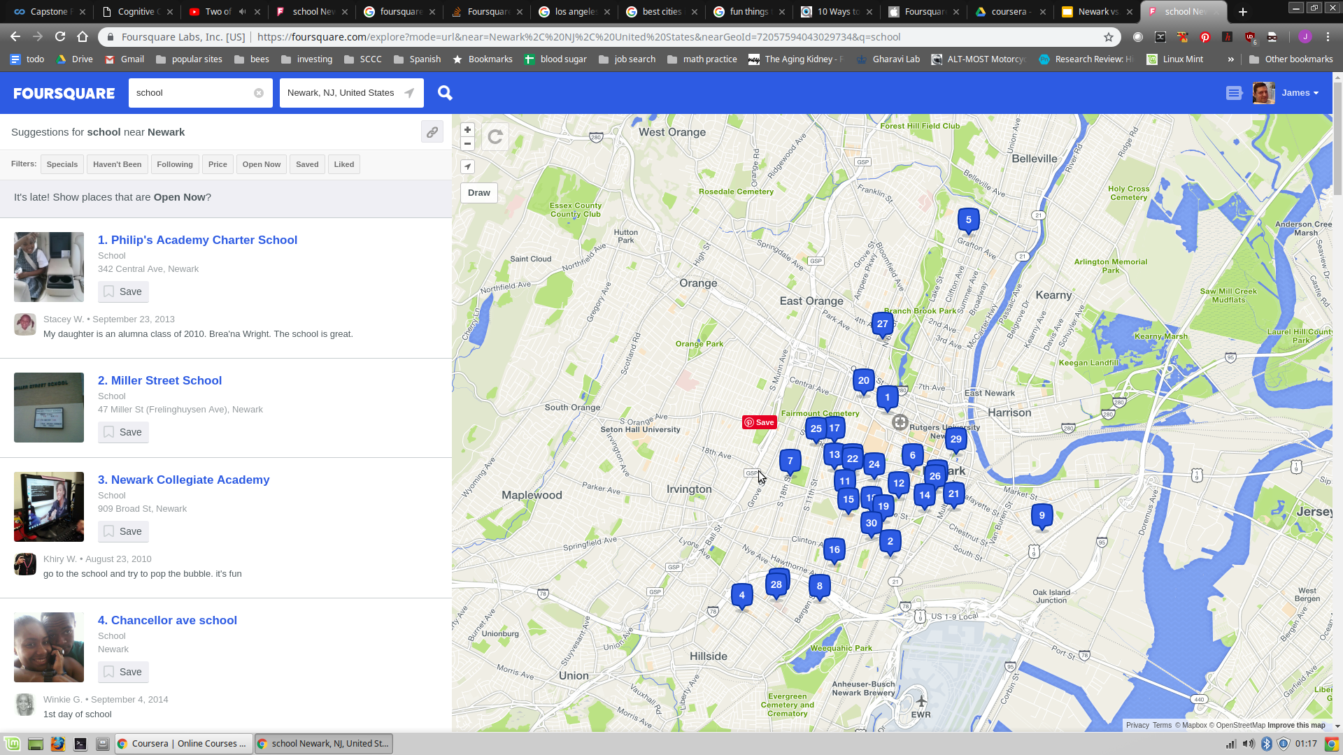
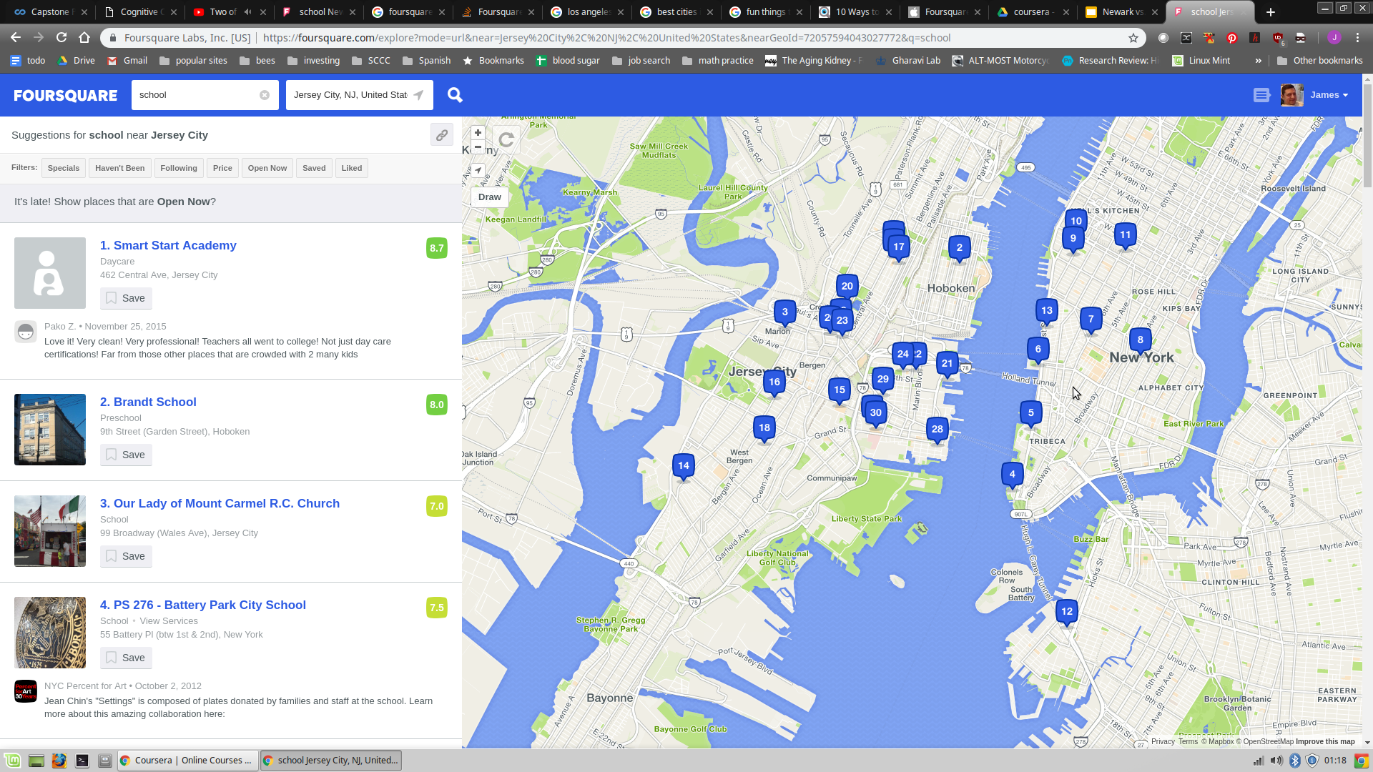
Newark vs. Jersey City - total schools:

Slide 5
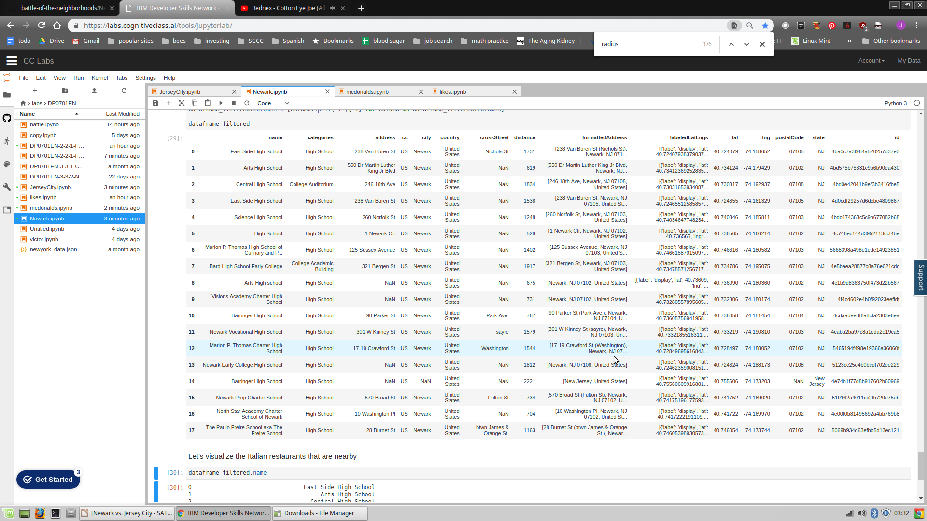
Newark has 18 high schools

Slide 6
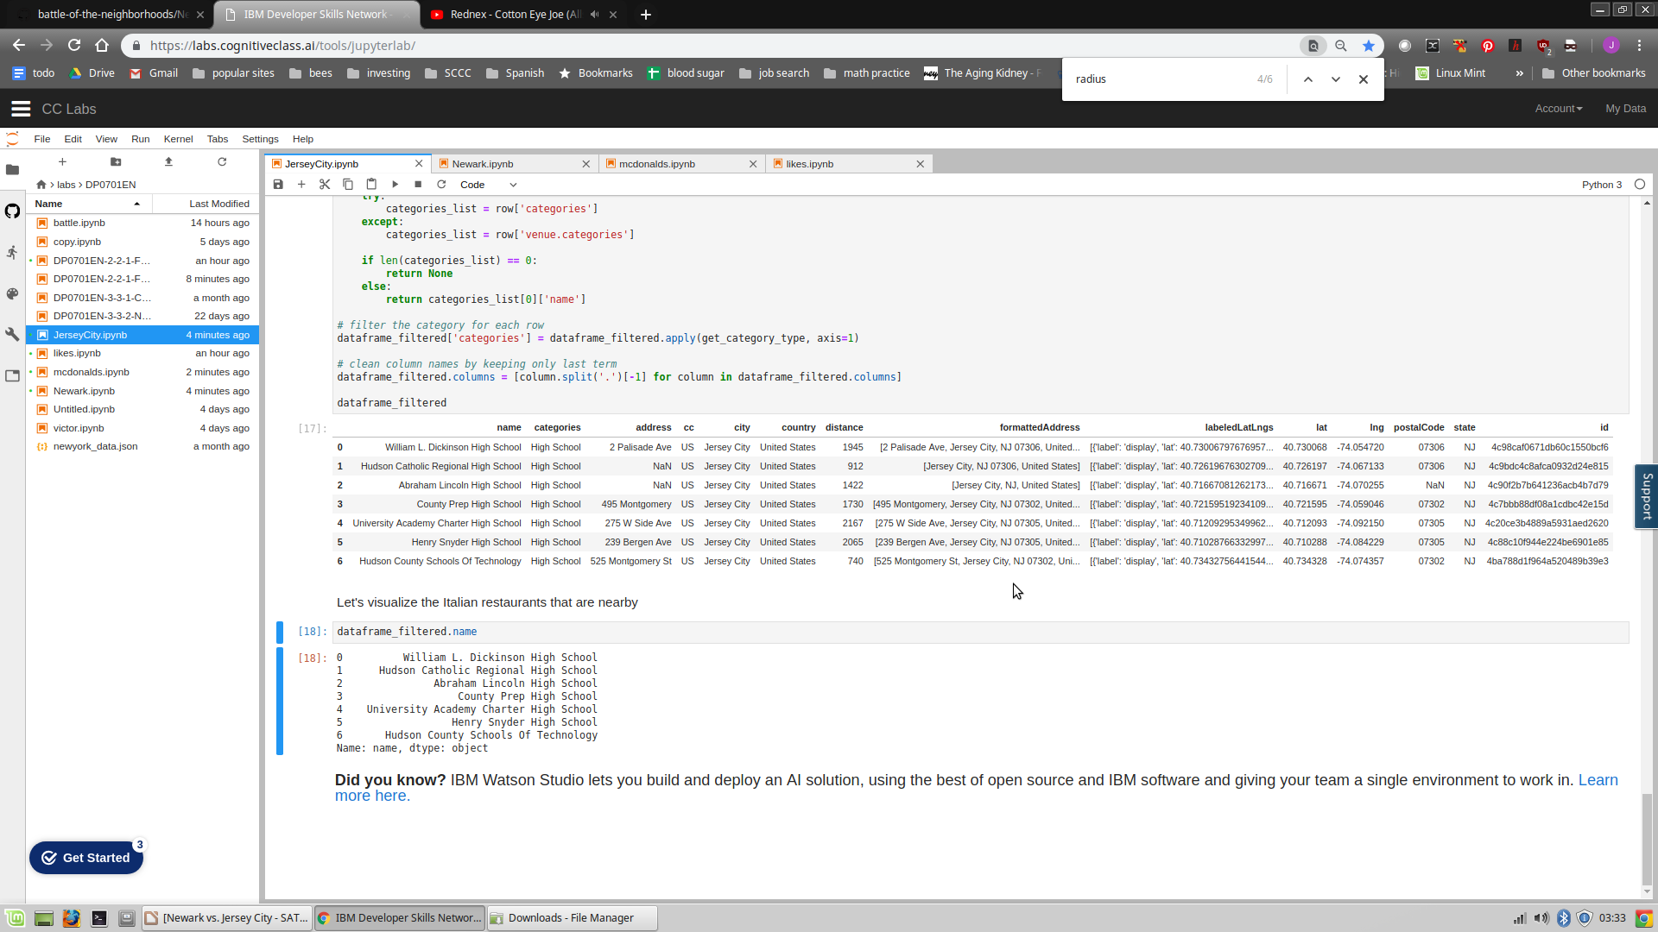
Jersey City has 8

Slide 7
NEWARK WINS!!
I will be searching for a nice mcdonalds ice cream with good reviews To set up my business near.

Slide 8
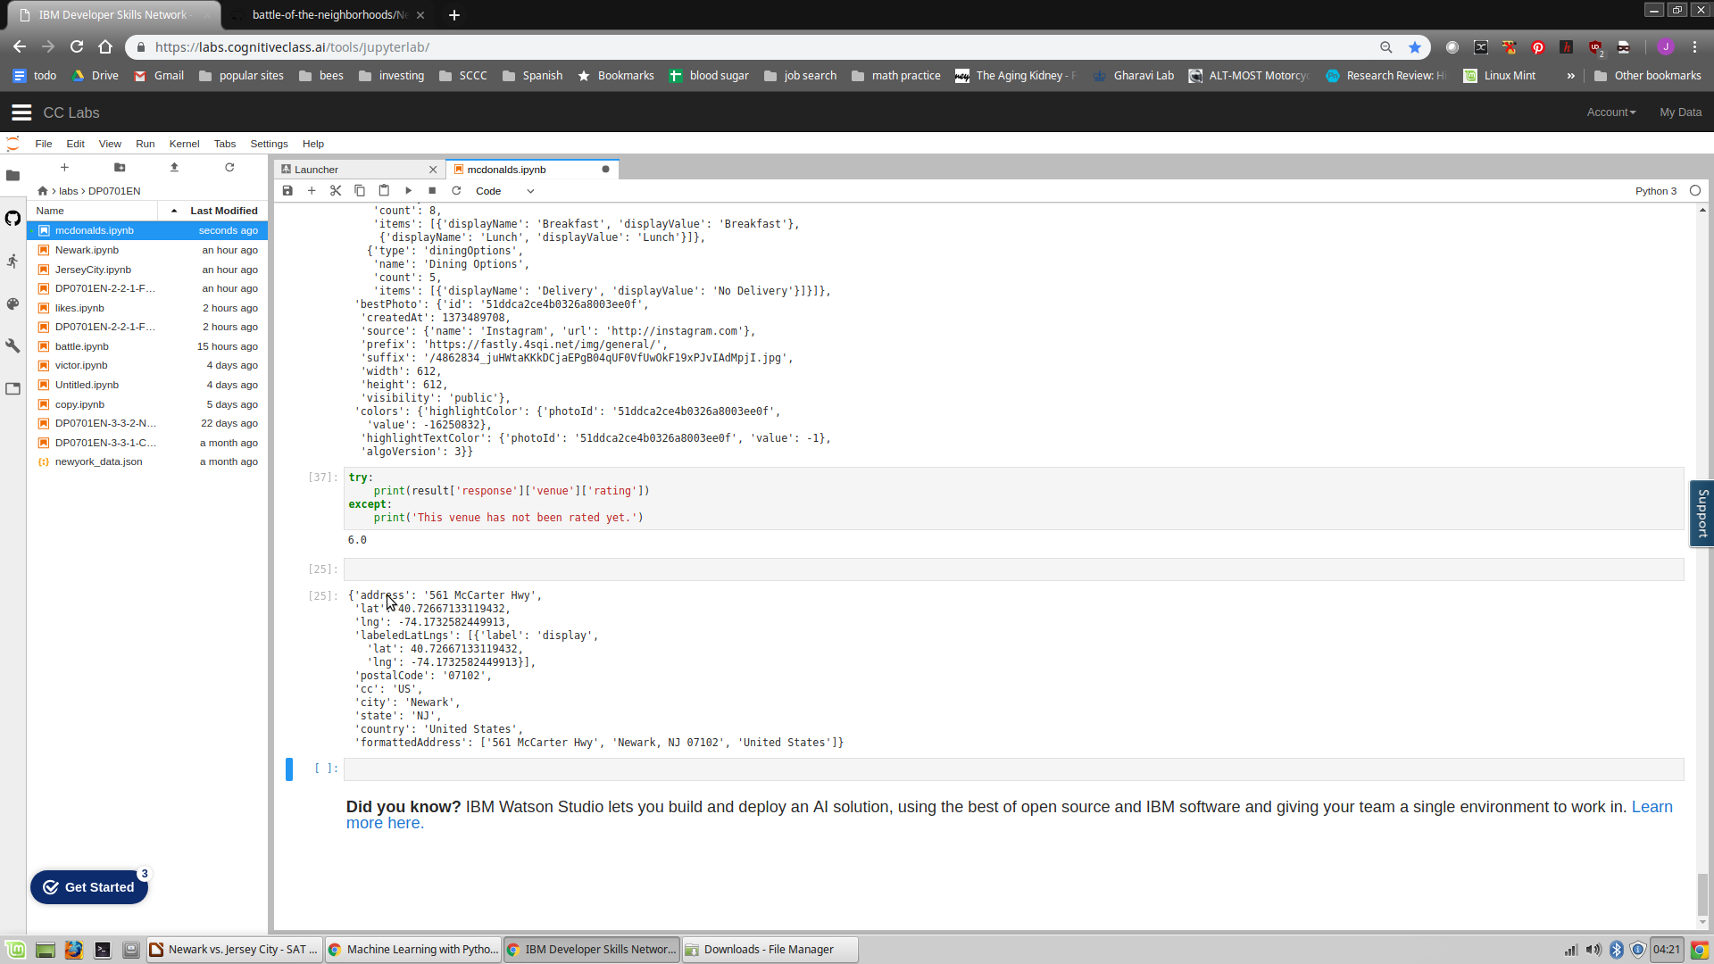
Found a mcdonalds with a 6.0
On 561 McCarter highway, so I will locate close to here!

Slide 9


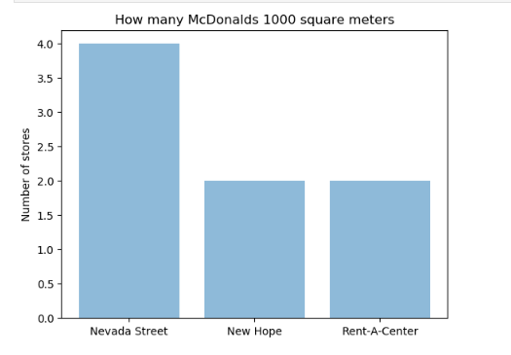
New Hope
Nevada Street

Slide 10
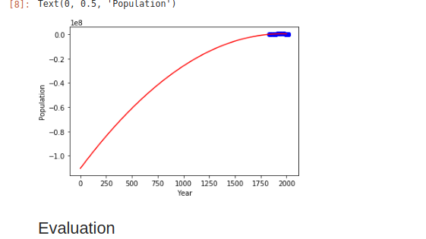
Regression line of Newark population

Slide 11
Correlation between murders and variables
( US GDP ) ??

Slide 12
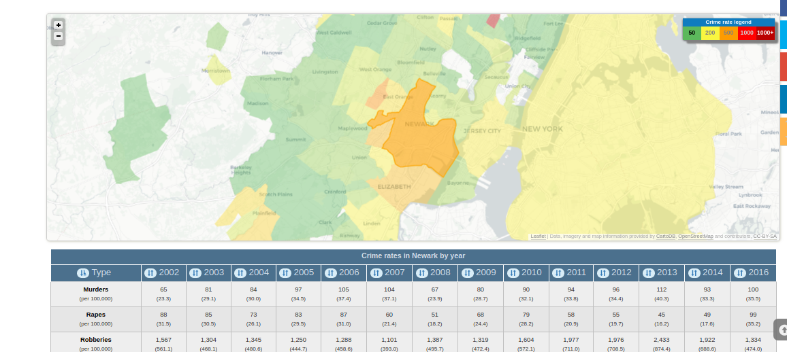

Slide 13
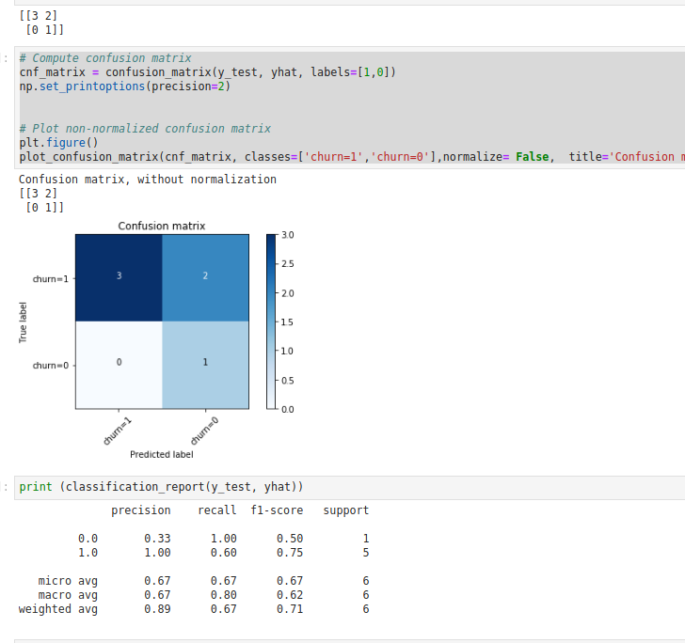
Logistic Regression
Based on the info, I can predict based on GDP, the chances of whether or not crime will increase!!

